Slide 1

Image Processing and Computer Vision Laboratory
CSE 4128
Project Title: Meme Generator
Supervised By:
Dr. Sk. Md. Masudul Ahsan
Professor
Department of CSE, KUET
Dipannita Biswas
Lecturer
Department of CSE, KUET
Submitted By:
Sk. Azraf Sami
Roll: 1907115
Year: 4th
Term: 1st
Date of Submission: 01-09-2024

Slide 2
Outline
Introduction
Features
UI
Add Text Tool
Padding Tool
Enhancement Tool
Collage Tool
Background Remove Tool
Add Credit Tool
Blurring Tool
Black/ White Tool
Application
Discussion
Conclusion

Slide 3
Introduction
This project leverages the power of Python and various image processing libraries to create a versatile tool for generating and editing memes. Memes have become a ubiquitous form of communication in the digital age, combining humor and imagery to convey messages effectively.

Slide 4
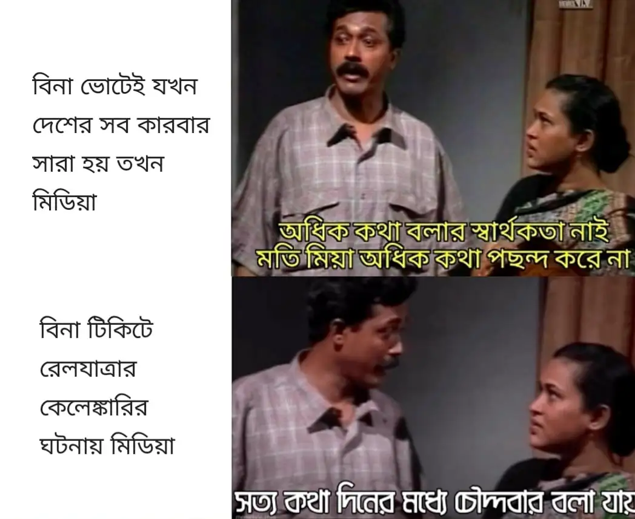
Introduction (contd..)
White Padding
Collage of two different images
Writing text on images and padding
Fig-1: Example of Meme

Slide 5
Features
Background Remove
Add Text
Add Credit
Padding
Upload Image
Blurring
Enhancement
Black-White
Collage
Fig-2: Block diagram of features

Slide 6
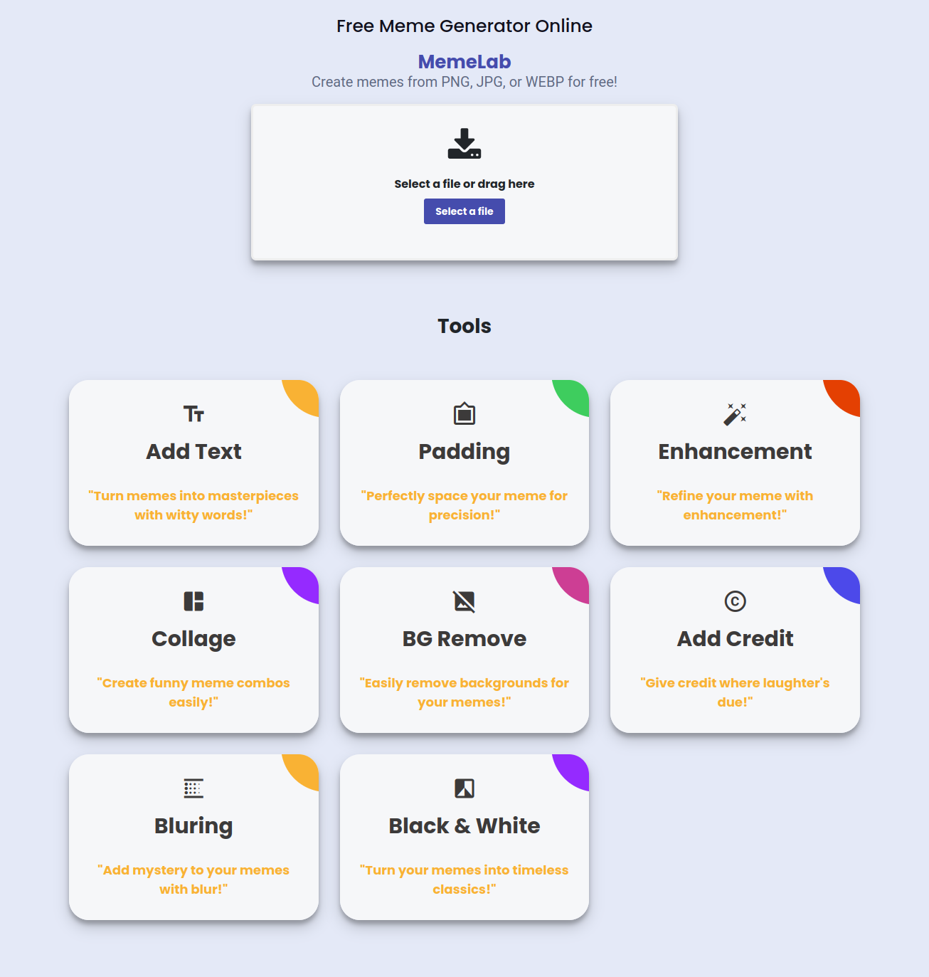
UI
Fig-3: Home Page

Slide 7
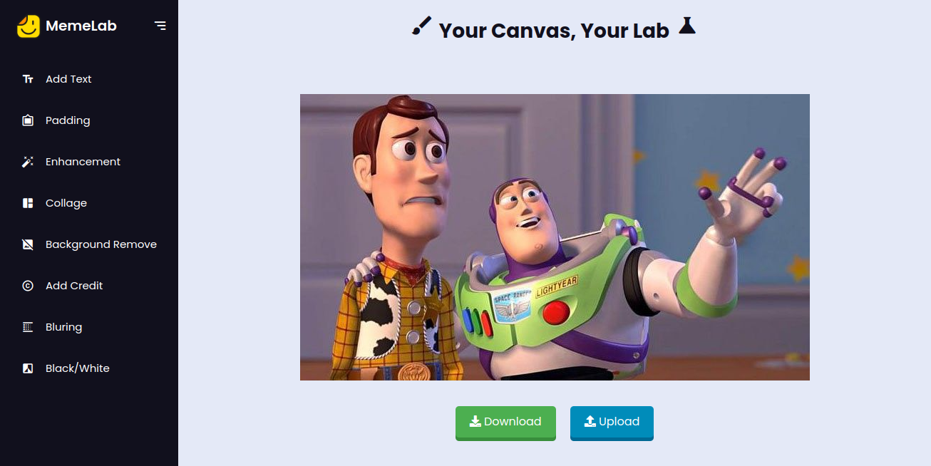
UI(contd..)
Fig-4: Tools page with tool name

Slide 8
Add Text
Flask Application
add_text Function
Load and Convert Image (image_path -> RGBA)
Parse text_position JSON
Load Font (arial)
Create Drawing Context
Draw Text on Image
Convert Image to RGB
Save Image to meme_path
Fig-5: Block Diagram of Adding Text Tool

Slide 9
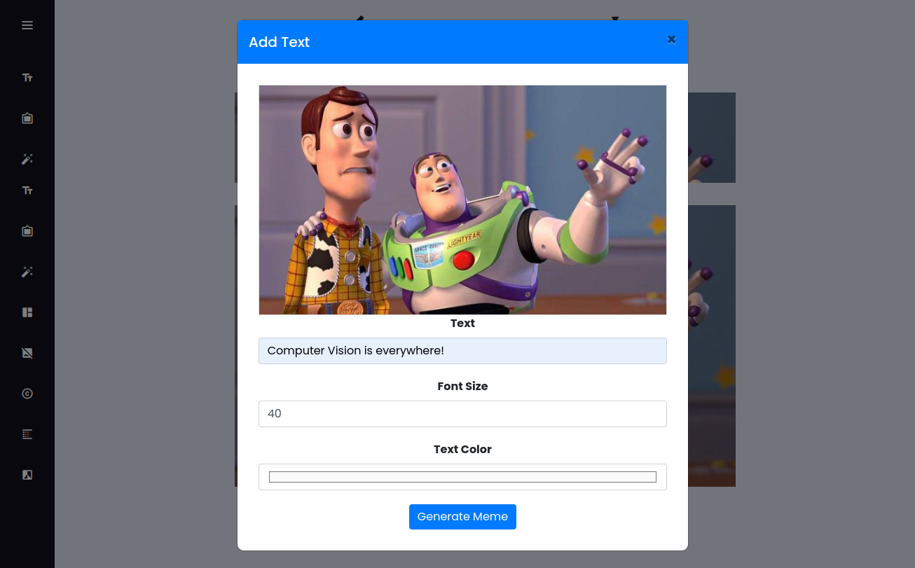
Add Text
Fig-6: Block Diagram of Adding Text Tool

Slide 10
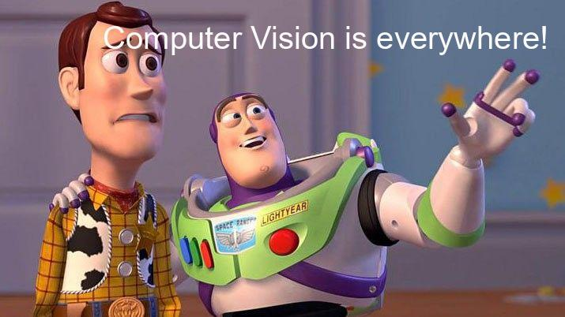
Add Text(contd..)
Fig-7: Output Image

Slide 11
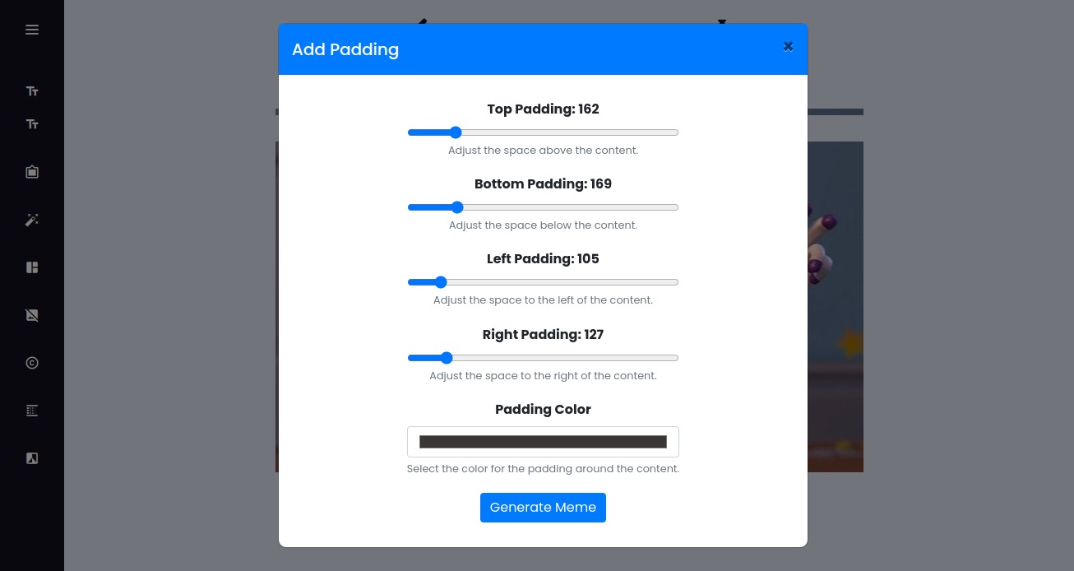
Padding
Fig-8: Padding Tool

Slide 12
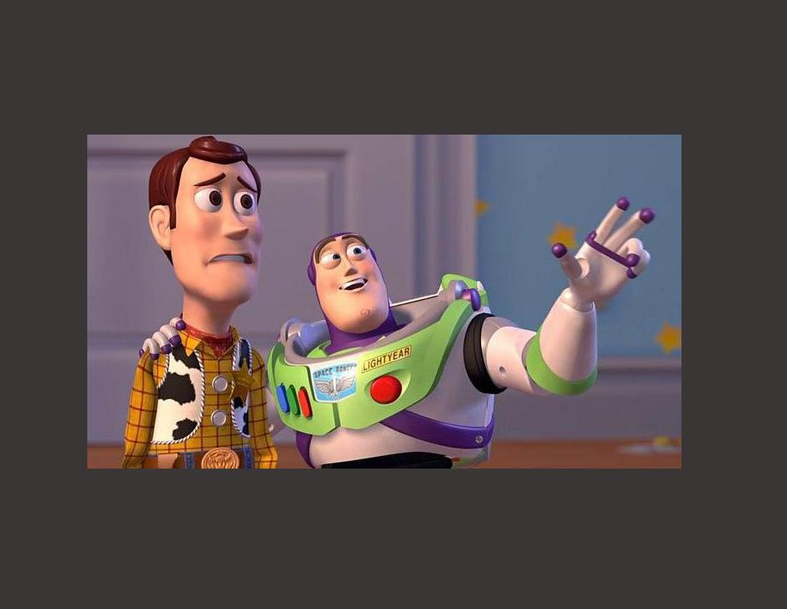
Padding(contd..)
Fig-9: Output Image padding Tool

Slide 13
Enhancement
histogram_equalization Function
Open and Convert Image
(PIL -> RGB -> NumPy)
Check Image Type (Grayscale or Color)
Grayscale Image
Compute Histogram, PDF, and CDF
Map Intensities using CDF
Color Image
Convert to YCrCb Color
Apply Histogram Equal to Y Channel
Merge Channels
Convert Back to PIL
(NumPy -> PIL)
Convert Back to RGB
Save Processed Image
(meme_path)
Fig-10: Block Diagram of Enhancement

Slide 14
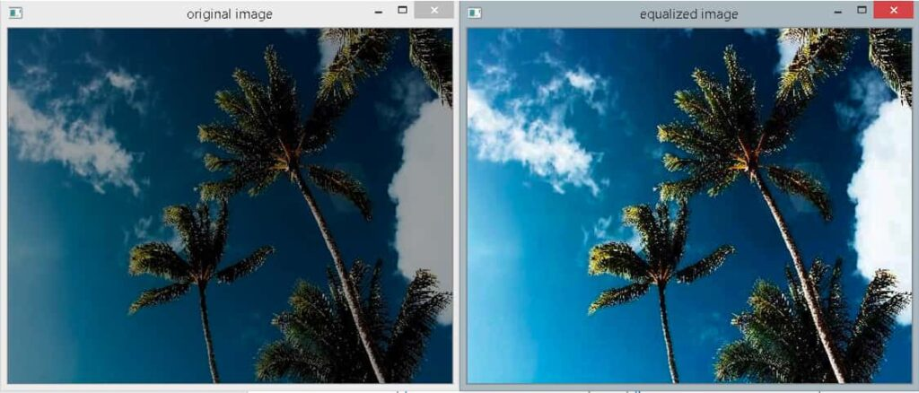
Enhancement (contd..)
Fig-11: Original and Enhanced Image

Slide 15
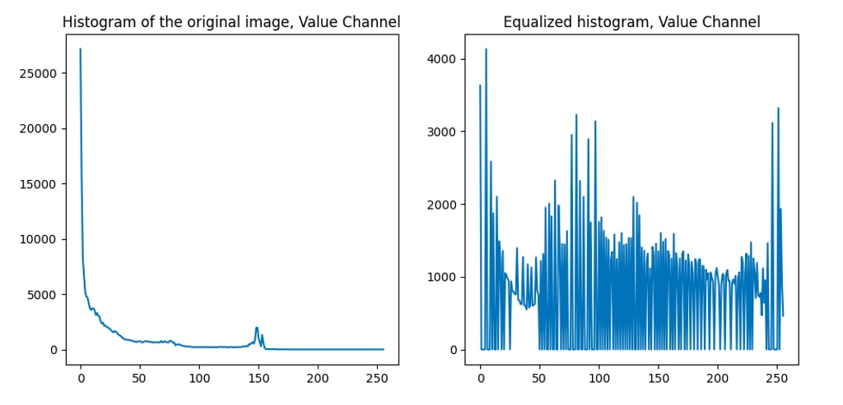
Enhancement (contd..)
Fig-12: Histogram

Slide 16
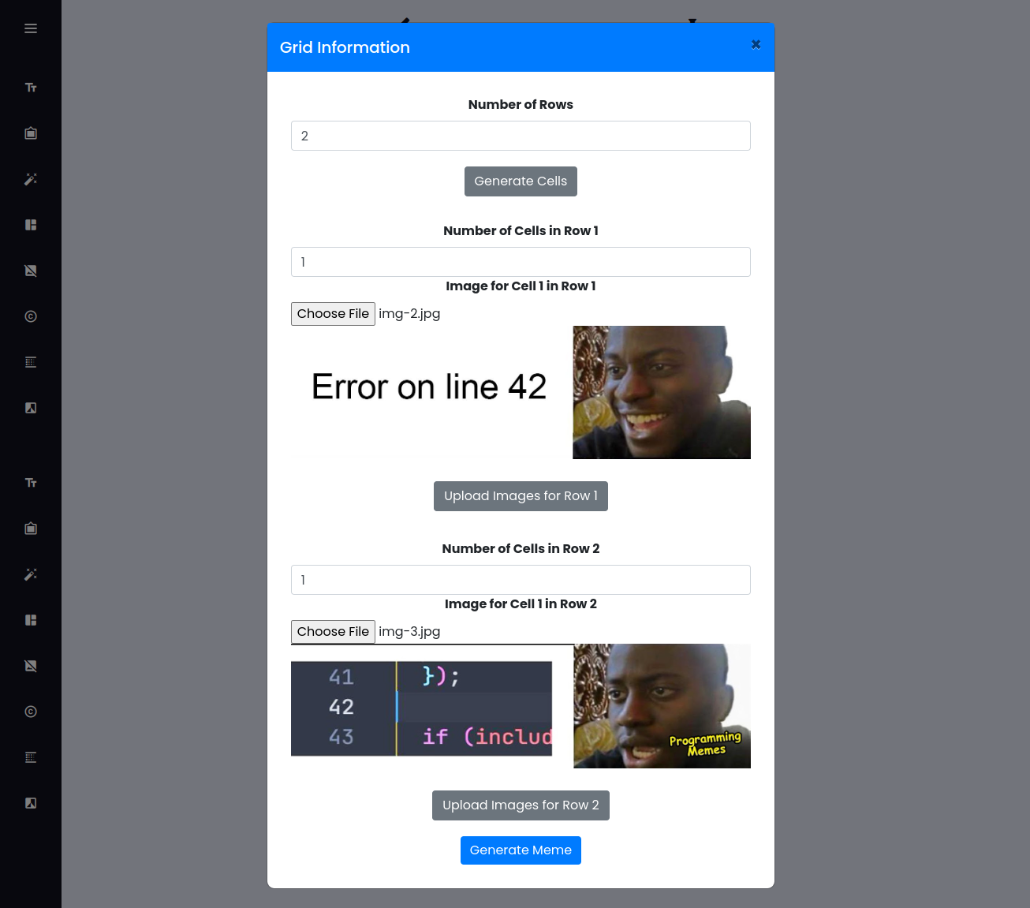
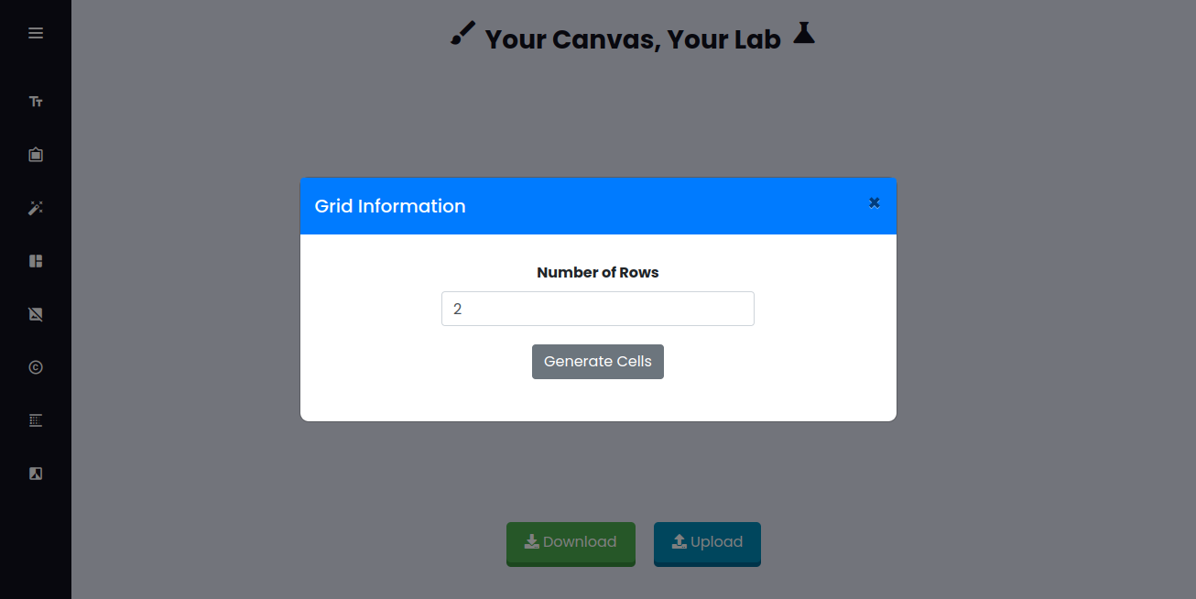
Collage(contd..)
Fig-13: Collage UI

Slide 17
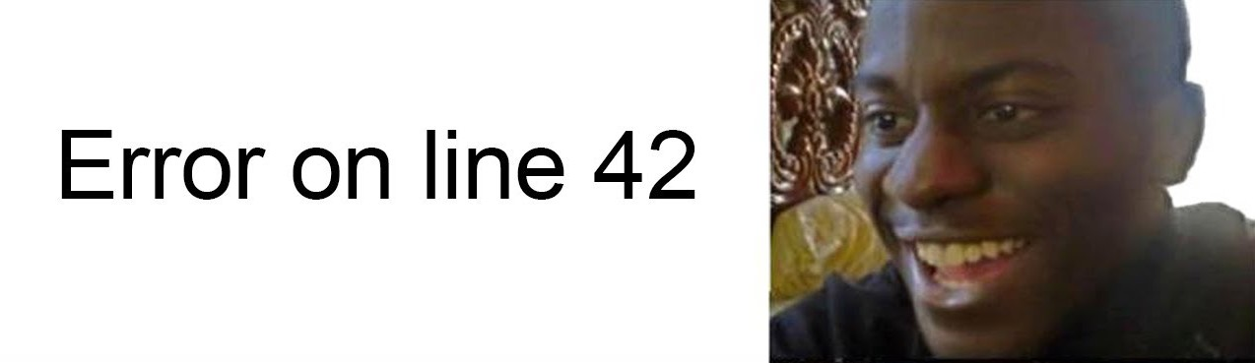
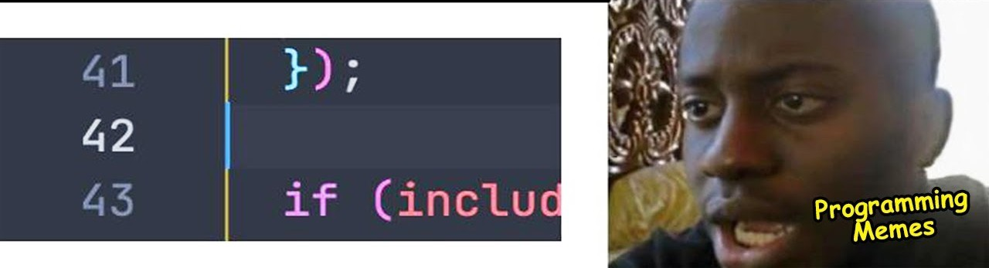
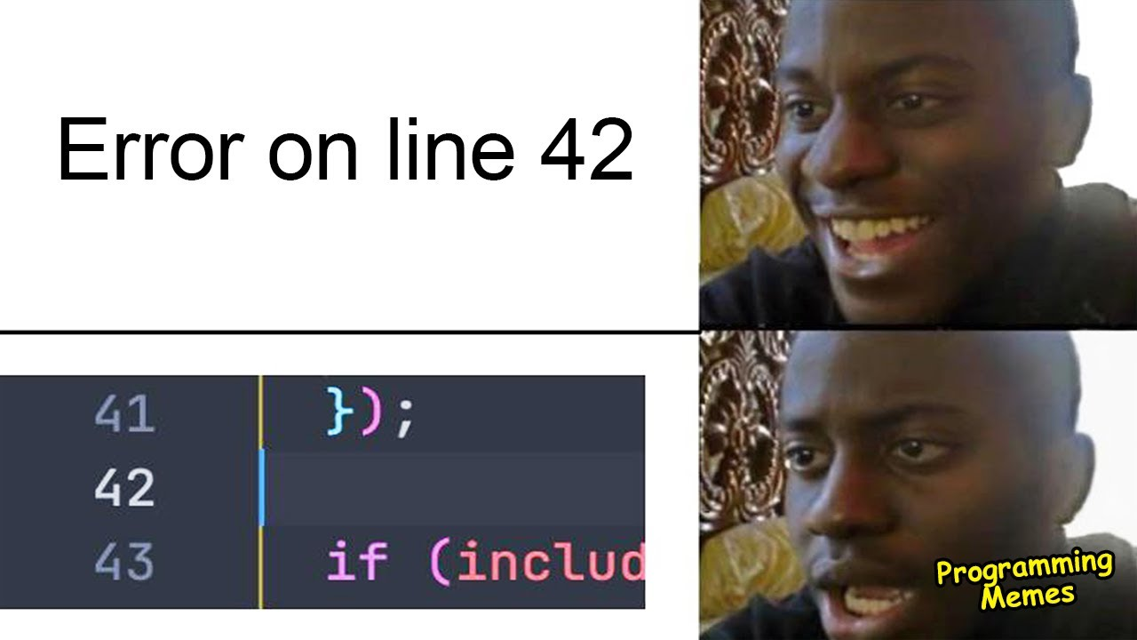
Collage(contd..)
Fig-14: Input Image-1
Fig-15: Input Image-2
Fig-16: Output Image (Collage of two images)

Slide 18
Background Remove
Load image from file
Convert image to NumPy
array (if needed, convert RGBA to RGB)
Initialize mask, bgd_mode fgd_model, and rectangle
Apply GrabCut algorithm with increased iterations
Create binary mask and apply to image
Add alpha channel to image
Convert back to PIL image
Create white background image
Paste processed image onto white background
Clean up edges using morphological operations
Fig-17: Block diagram of background remove tool

Slide 19
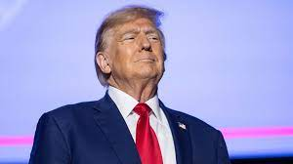

Background Remove(contd..)
Fig-18: Input Image
Fig-19: mask

Slide 20
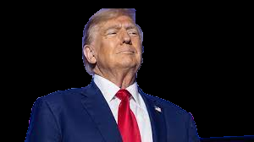

Background Remove(contd..)
Fig-20: Foreground Image
Fig-21: Morphology

Slide 21
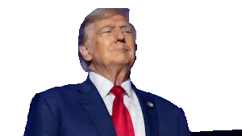
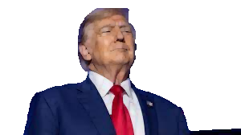
Background Remove(contd..)
Fig-22: RGBA Transparent
Fig-23: Final Output Image

Slide 22
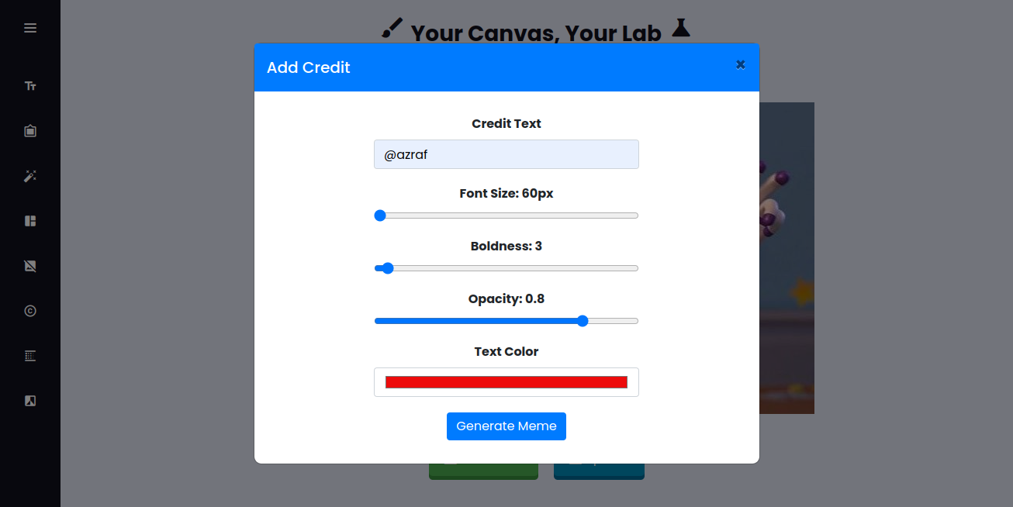
Add Credit
Fig-24: UI of add credit tool

Slide 23
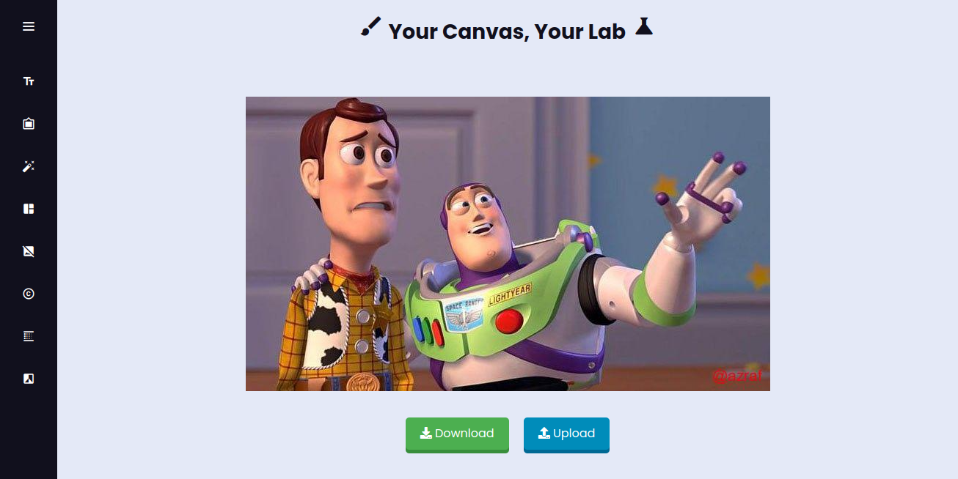
Add Credit(contd..)
Fig-25: Output Image

Slide 24
Blurring
Load Image
Convert to NumPy Array
Ensure Kernel Size is Odd
Create Gaussian Kernel
- Generate Coordinates
- Compute Gaussian Values
- Normalize Kernel
Apply Kernel to Image
- Normalize Image
- Pad Image
- Convolve with Kernel
- Clip and Convert to 8-bit
Save Blurred Image
Fig-26: Block diagram of blurring tool
Return path of saved image

Slide 25
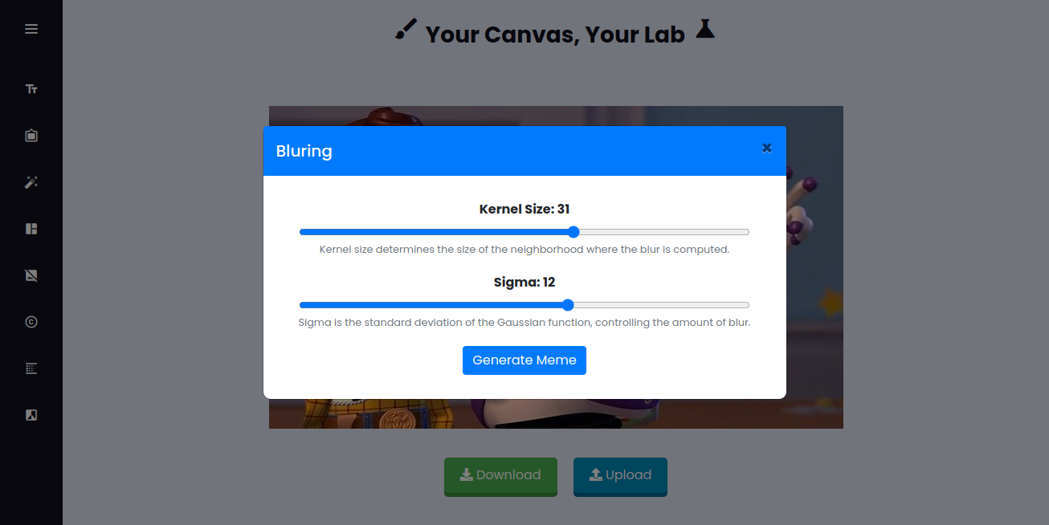

Blurring
Fig-27: Adjusting Parameters
Fig-28: Output Image

Slide 26
Black/White
Define convert_to_black_and_white function
Open image with PIL
Convert the image to grayscale
Open image with PIL
Save the grayscale image
Return path of saved image
Fig-29: Block diagram of black/white tool

Slide 27
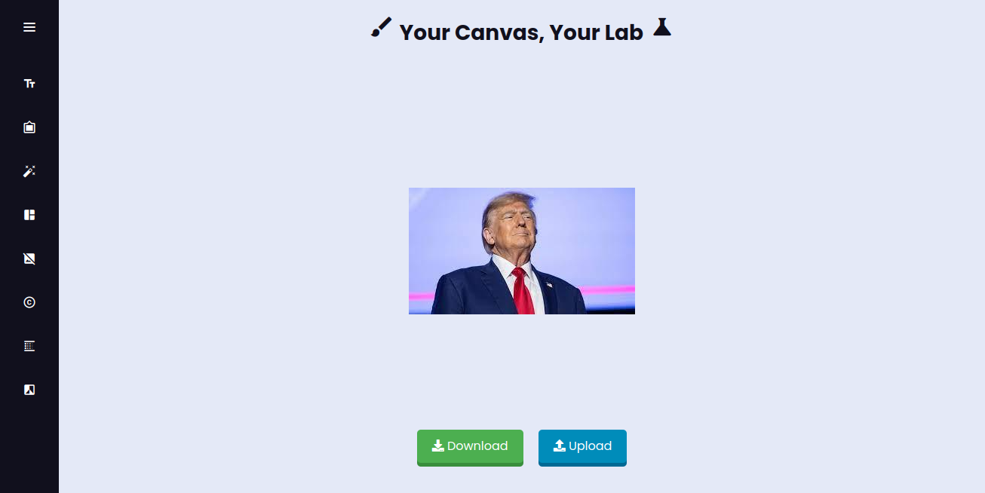
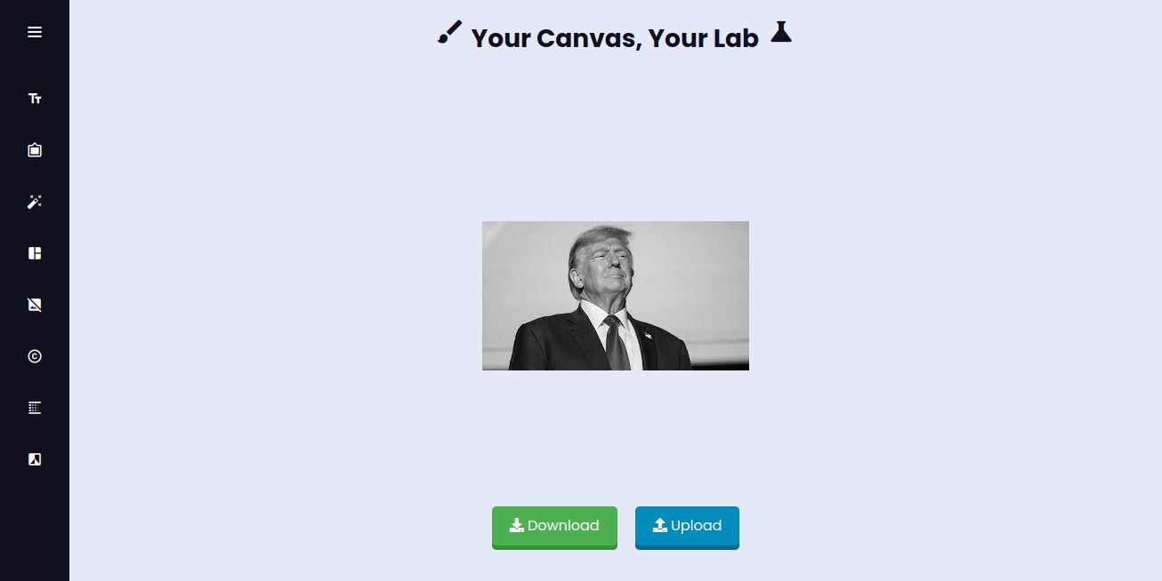
Black/White
Fig-30: Input Image
Fig-31: Output Image

Slide 28
Application
Social Media Engagement: Enhancing posts with custom memes.
Educational Tool: Demonstrating image processing and computer vision.
Marketing and Branding: Engaging audiences with viral content.
Personalized Content Creation: Customizing memes for individual expression.
Research and Development: Experimenting with image processing algorithms

Slide 29
Discussion
Advanced Features: Supports text addition, collage creation, histogram equalization, and background removal.
Implementation Challenges: Addressed image format compatibility, real-time performance, and intuitive UI design.
User Feedback: Improved text handling and processing speed based on user input.
Versatile Tool: Combines practical use with educational value for both casual users and academic settings.

Slide 30
Conclusion
Successful Achievement: The project meets its goals of offering a user-friendly platform for creating and sharing memes while exploring advanced image processing techniques.
Diverse Applications: Applicable in social media, education, marketing, and research, highlighting the intersection of technology and creativity.
Future Enhancements: Potential improvements include expanding editing tools, enhancing real-time collaboration, and integrating cloud-based storage.
Valuable Insights: The project provided insights into image manipulation complexities and opportunities for innovation in digital content creation.

Slide 31
Thank You

